Slide 1


DIGITAL THERMOMETER USING 8051 and ARDUINO UNO
SUBMITTED TO:
Mr.Abhinav Karan
Assistant Professor
Dept. of ECE,
SOE-DSU
SUBMITTED BY:
Abhiram M V-ENG18EC0002
Amit Jamshetty-ENG18EC0009
B H Bhargav-ENG18EC0017
Manoj G Sonny-ENG18EC0060

Slide 2

TABLE OF CONTENTS
1.INTRODUCTION
6.IMPORTANT POINTS
7.APPLICATIONS
2.COMPONENETS DESCRIPTION
5.CODE
8.CONCLUSION
3.CIRCUIT DIAGRAM
4. WORKING
9.REFERENCES

Slide 3

INTRODUCTION
Thermometer is a temperature measuring instrument. There are different principles that can be used to measure the temperature like thermal expansion of solids or liquids, pressure of gas, measurement of infrared energy etc.
Based on the principle used, the construction and functioning of the thermometer can change but ultimately it ends up measuring the temperature. Thermometers are used in industries, weather studies, medicinal field and scientific research.

Slide 4
Measuring temperature is an important part of many applications. Maintaining precise temperatures in storage rooms, laboratories, incubators, etc. is of high priority.
For all the above mentioned and many more applications, thermometers are often used to measure the temperature.
There are different types of thermometers available for different purposes. The most commonly found thermometer is a medical or clinical thermometer, which is a mercury in glass type thermometer.
They are used to measure the temperature of human body and is an example of an analogue thermometer. Now a days, the use of digital thermometers is increasing as they are accurate and safe to use.

Slide 5
COMPONENTS USED FOR DIGITAL THERMOMETER USING 8051
8051 development board
ADC0804 board
16*2 LCD display
LM35 sensor

Slide 6
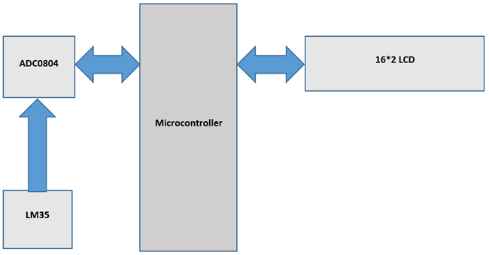
COMPONENTS DESCRIPTION
1.8051 development board-
8051 Microcontroller is a 8 bit microcontroller which has 128 bytes of on chip RAM , 4K bytes of on chip ROM, two timers, one serial port and four 8 bit ports.
8052 microcontroller is an extension of microcontroller. The table below shows the comparison of 8051 family members.

Slide 7
2. 16x2 LCD -
16x2 LCD is a widely used display for embedded applications.There are two very important registers inside the LCD. They are data register and command register. Command register is used to send commands such as clear display, cursor at home etc., data register is used to send data which is to be displayed on 16*2 LCD.
3. ADC0804 IC -
The ADC0804 IC is an 8-bit parallel ADC in the family of the ADC0800 series from National Semiconductor. It works with +5 volts and has a resolution of 8 bits. The step size and Vin range varies for different values of Vref/2. The table below shows the relation between Vref/2 and Vin range.
4. LM35 Temperature Sensor -
The LM35 is a temperature sensor whose output voltage is linearly proportional to Celsius temperature. The LM35 comes already calibrated hence requires no external calibration. It outputs 10mV for each degree of Celsius temperature.

Slide 8
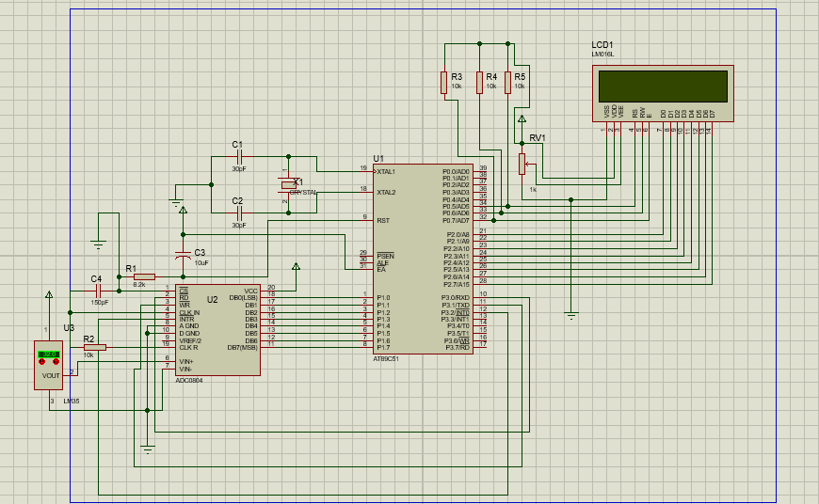
CIRCUIT DIAGRAM USING PROTEUS

Slide 9
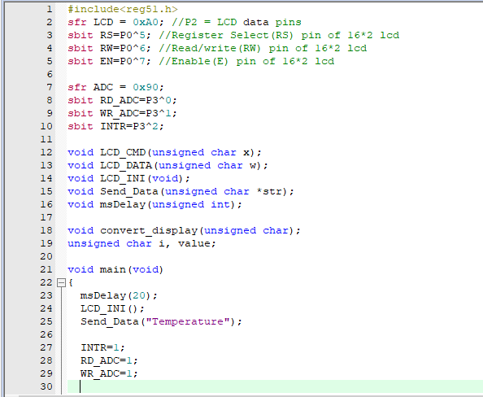
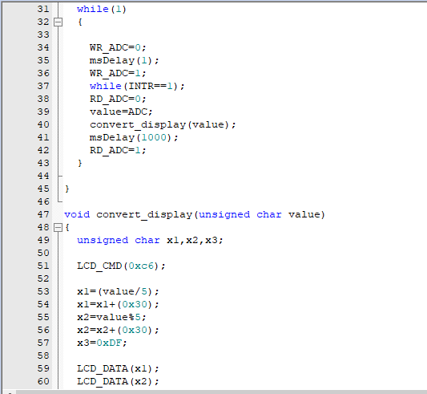
CODE

Slide 10
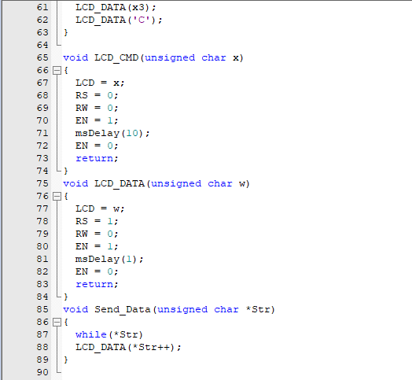
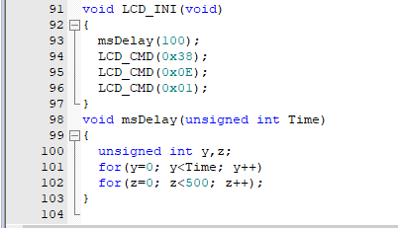
CODE (Continued)

Slide 11
WORKING OF DIGITAL THERMOMETER USING 8051
It consists of LM35,8051 Microcontroller,ADC 0804,16X2 Alphanumeric LCD.
8051 consists of 40 pins,ADC 0804 contains 20 pins and LCD has 14 pins.
Resistors,POT,crystal oscillator and capacitors of required values are used. The circuit connections are made.
The 8051 microcontroller performs the required operation upon adding the code to it
The code is written using C programming with Keil uvision and it is further converted into hex file to use in the circuit constructed in Proteus.
Here ADC0804 converts the temperature in Analog form to digital form and provides the output in the 16X2 LCD.
The LCD will be able to display the precise output upon conversion.

Slide 12
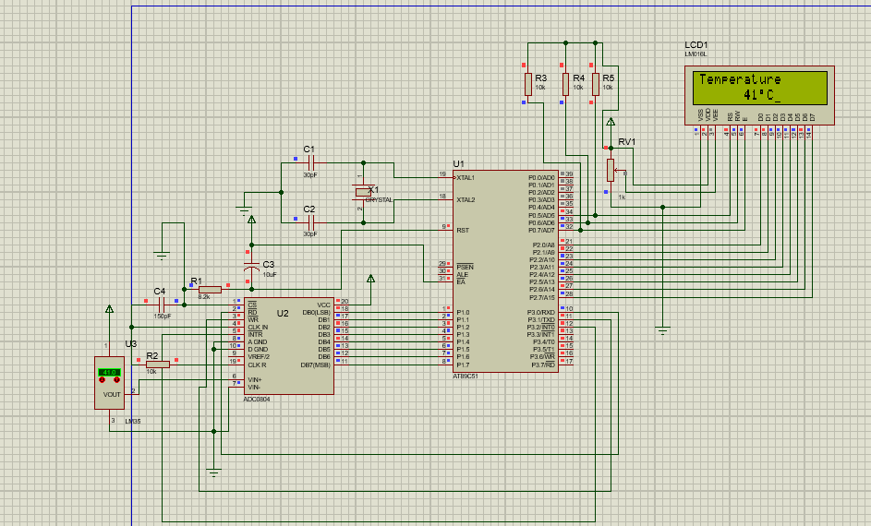
WORKING SIMULATION

Slide 13
DIGITAL THERMOMETER USING ARDUINO UNO
In this project, an Arduino based digital thermometer is designed that can be used to monitor the temperature of room.
Arduino is an open source development board through which many of the projects can be done.
This project uses arduino UNO,16X2 Alphanumeric LCD display and LM35 temperature sensor.

Slide 14
COMPONENTS USED FOR DIGITAL THERMOMETER USING ARDUINO
ARDUINO UNO
POT(Variable resistor)
16*2 LCD display
LM35 sensor

Slide 15
CIRCUIT DESIGN
LM35 is the temperature sensor used in this project. The output of the sensor is directly proportional to the temperature but in analogue form. Hence, the output of LM35 i.e. pin 2 is connected to analog input A0 of Arduino.
As it is a digital thermometer, we need to convert the analogue values to digital and display the result on a display like LCD. We used a 16X2 LCD in this project. Pins 1 and 2 of LCD are connected to ground and supply respectively.
In order to control the contrast of the display, Pin 3 of LCD is connected to the wiper of a 10 KΩ POT. The other terminals of POT are connected to supply and ground. Pins 15 and 16 of LCD are used to turn the backlight of the LCD.

Slide 16
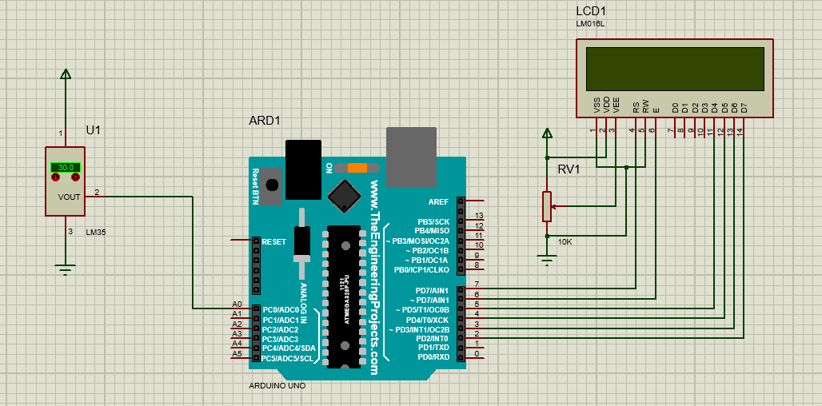
CIRCUIT DIAGRAM FOR DIGITAL THERMOMETER USING ARDUINO UNO

Slide 17
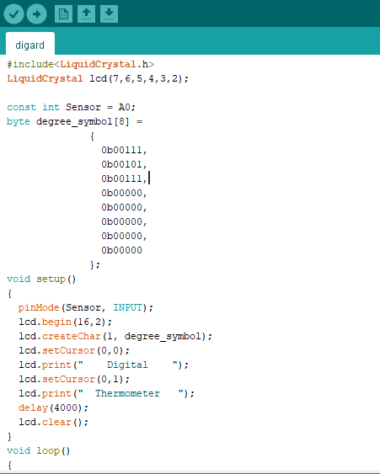
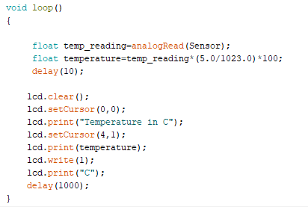
CODE

Slide 18
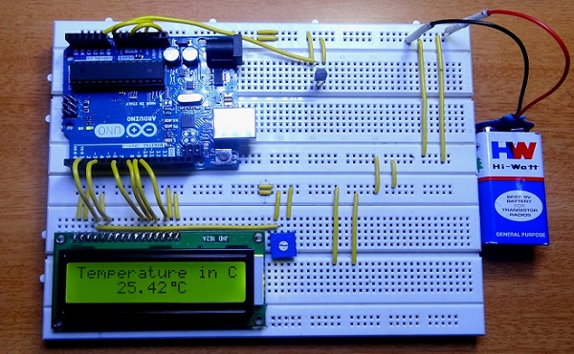
WORKING
A high precision digital thermometer is designed in this project. It is constructed with simple components like Arduino, LM35 temperature sensor and an LCD display. The working of the circuit is very simple and is explained below.
The temperature sensor i.e. LM35 continuously monitors the room temperature and gives an analogue equivalent voltage which is directly proportional to the temperature.
This analogue data is given to Arduino through A0. As per the code written, the Arduino converts this analogue voltage value to digital temperature readings. This value is displayed on the LCD.
The rate of change of temperature capture can be programmed in the code. The output displayed on the LCD is an accurate reading of room temperature in centigrade.

Slide 19
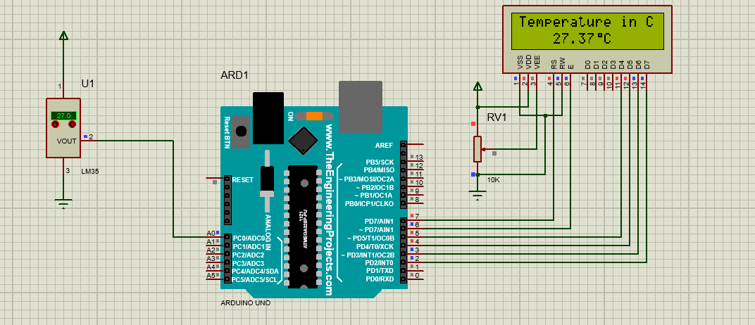
WORKING SIMULATION IN PROTEUS

Slide 20





NOTE POINTS
This project can be used to monitor temperature of a room with in a range of -55⁰C to +150⁰C with very accurate readings.
The temperature sensor used (LM35) is a precision centigrade temperature sensor. If the readings of the temperature are required in Fahrenheit, then either Fahrenheit temperature sensor (LM35) can be used or simply modify the code for converting Centigrade to Fahrenheit.
The thermometer can be powered by a 9V battery making it a portable device that can be easily moved between different rooms or locations.
Can be used in transportation vehicles to determine the icing conditions of the road.
Based on the readings of the thermometer, the air conditioning systems, heating and cooling systems can be controlled either manually or automatically.

Slide 21


APPLICATIONS
Temperature monitoring system in industries as well as in fire alarm systems where high rise in temperature results in fire or damage to equipments.
Monitor the ambient temperature and record the rise or fall in temperature.
This controller can accept a variety of inputs to measure different variables such as temperature transducer, strain gauges, load cells, flow, pressure, level, speed, time, by way of suitable interfacing and programming.

Slide 22
CONCLUSION -
Digital Thermometer using 8051 microcontroller and ARDUINO UNO is constructed. The system consists of a combination of hardware and software. The system has relatively fast response and high accuracy. The overall system is also quite simple to implement and relatively cheap.

Slide 23

REFERENCES
https://youtu.be/7VTYBKf9Cqk
http://circuitdigest.com/microcontroller-projects/digital-thermometer-using-lm35-8051
https://www.electronicshub.org/arduino-based-digital-thermometer/

Slide 24

THANK YOU!!!

